Slide 1
GLUCOSENSE
(AI-POWERED DIABETES DETECTION
FOR EARLY INVENTION )

Slide 2



PRESENTATION BY
Thota Rahul
Chede Rethasvi
Shantanu Punwatkar

Slide 3
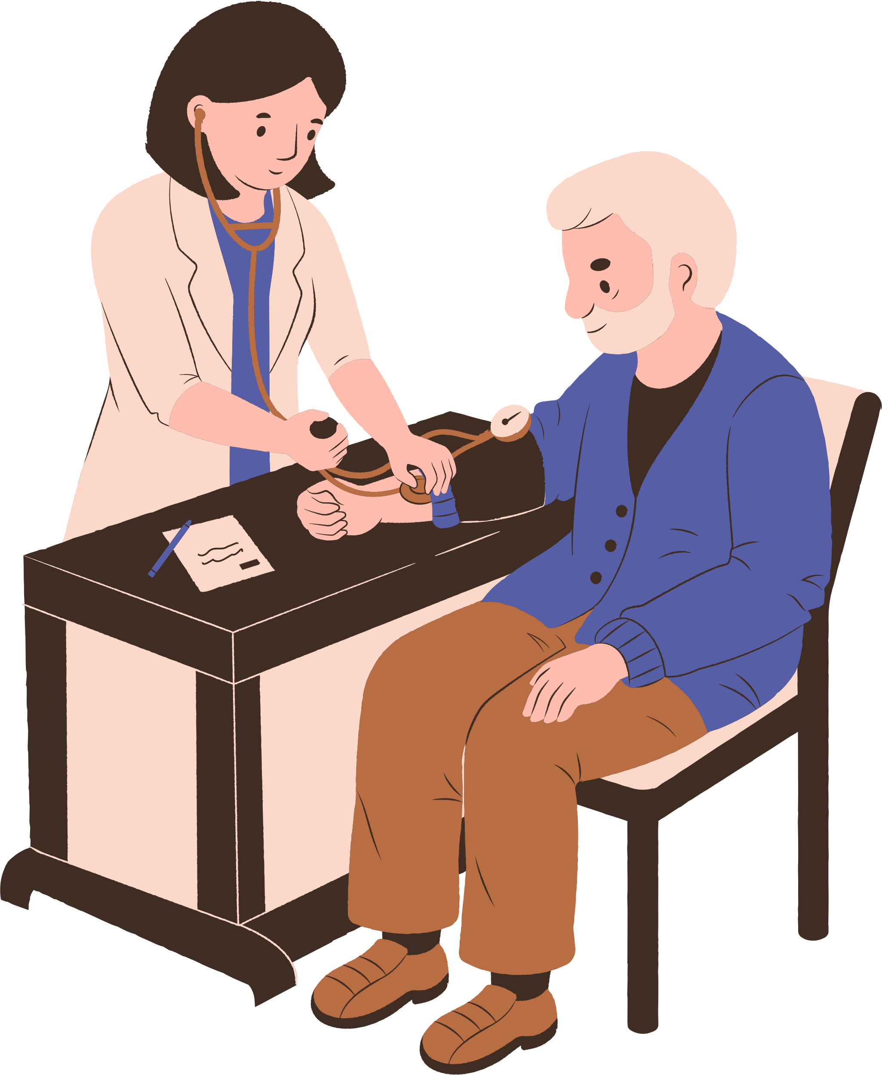

PROBLEM STATEMENT
Diabetes is a growing global health issue, with cases rising significantly over the past 15 years due to lifestyle factors.
Early detection can prevent complications and improve health outcomes.
Objective:
To develop an AI-powered model that predicts a person’s diabetes status (Healthy, Pre-Diabetic, or Diabetic) using healthcare and lifestyle data

Slide 4
STEPS INVOLVED
Data Collection: Gather healthcare and lifestyle survey statistics
EDA & Preprocessing: Explore data, handle missing values, and normalize
Feature Selection: Identify important features, apply reduction techniques
Build Model: Train and test classification models
Evaluation Metrics: Use Accuracy, Precision, Recall, and F1-Score

Slide 5
DATASET OVERVIEW
Records: 520 rows | Features: 17 (16 input, 1 output)
Purpose: Predict diabetes from healthcare & lifestyle data
Key Features:
Age: Numerical
Gender: Male/Female
Symptoms: Polyuria, Polydipsia, etc. (Binary)
Lifestyle Factors: Obesity, Alopecia, Muscle Stiffness, etc. (Binary)
Data Insights:
Class Distribution: Likely imbalanced (more non-diabetic cases)
Data Quality: No missing values; binary features except Age

Slide 6
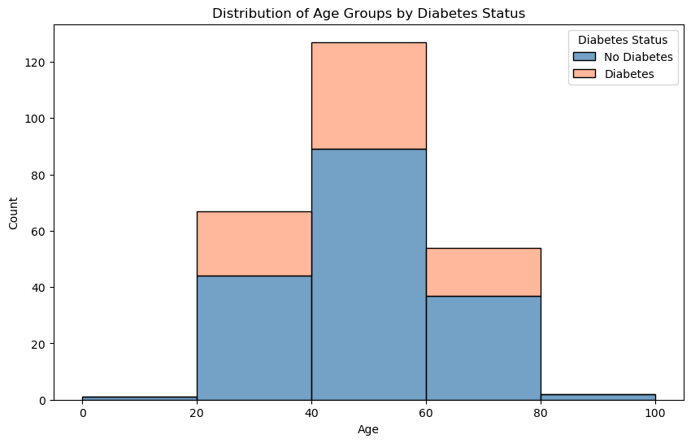
EXPLORATORY DATA ANALYSIS
Purpose: Highlight the patterns, trends, and distributions in the data.
Univariate Analysis: Distribution of Age, Gender, and other features using histograms.
Bivariate Analysis: Correlation between features (e.g., Age vs. Class) using scatter plots or heatmaps.
Outliers: Visuals showing box plots for features like Age.
Class Distribution: Bar chart showing the ratio of diabetic vs. non-diabetic samples.
Visuals: Heatmap for correlation analysis, Boxplots for visualizing outliers in features like Age, Histograms to show the distribution of key features like Age

Slide 7
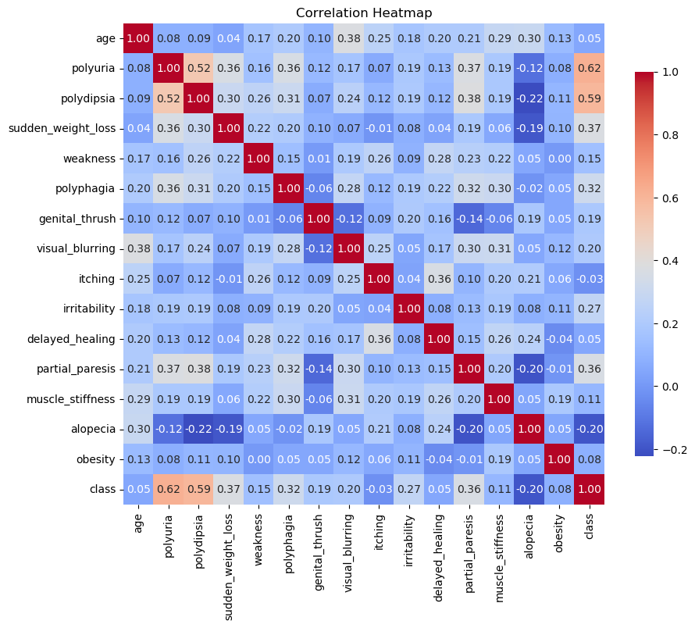
FEATURE SELECTION
Key Observations from the Correlation Matrix: Strong Correlation with Class (Target): Polyuria (0.62) and Polydipsia (0.59) are strong indicators of diabetes.
Moderate Correlation Among Symptoms: Polyuria and Polydipsia (0.52) often occur together. Weakness and Sudden Weight Loss (0.36) show a moderate relationship.
Low or No Correlation: Alopecia, Genital Thrush, and Muscle Stiffness have low predictive power for diabetes.
Age: Age has very low correlation with most symptoms and may not strongly predict diabetes in this dataset

Slide 8
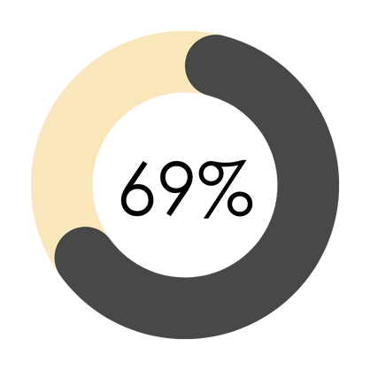
TARGET VARIABLE
69% of individuals in the dataset are diagnosed with diabetes
31% of individuals in the dataset do not have diabetes

Slide 9

CLASSIFICATION MODELS
Logistic Regression (LR): Linear model, predicts probabilities using the logistic function.
Support Vector Machine (SVM): Uses hyperplanes, effective for high-dimensional data.
Random Forest (RF): Ensemble of decision trees, reduces overfitting.
Decision Tree (DT): Simple, interpretable, splits data by features.
Extra Trees (ET): Random splits, improves variance reduction.
Gradient Boosting (GB): Sequential models to minimize error.

Slide 10
METRICS FOR MODELLLING
Model | Accuracy | Precession | Recall | F1 Score
Logistic Regression | 0.823529 | 0.822861 | 0.823529 | 0.813072
Support Vector Machine | 0.921569 | 0.921947 | 0.921569 | 0.920044
Random Forest | 0.941176 | 0.940959 | 0.941176 | 0.940642
Decision Tree | 0.843137 | 0.842132 | 0.843137 | 0.836172
Extra Trees | 0.921569 | 0.921947 | 0.921569 | 0.920044
Gradient Boosting | 0.901961 | 0.903628 | 0.901961 | 0.898904

Slide 11
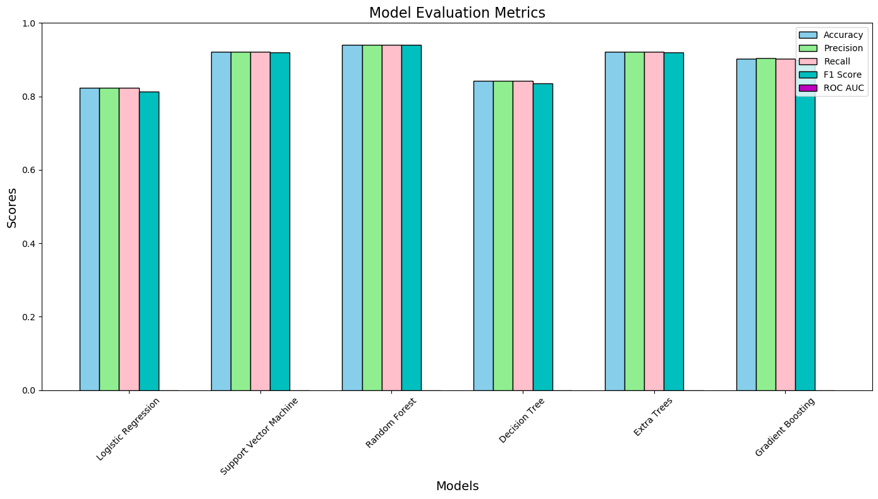
MODEL EVALUATION METRICS

Slide 12
CONCLUSION
Based on the analysis random forest model is the best.
* It gives best overall performance
* It ensures reliable predictions and capturing the majority of true positives.
* Random forest is suitable for small datasets
* It reduces the risk of overfitting while effectively handling small datasets.
* Compared to remaining models, random forest is computationally less complex, making it faster and easier.
* Hence, random forest is the best choice due to its performance and efficiency for small datasets, ensuring optimal predictions with minimal complexity. Where as other model’s extra trees, SVM, and decision tree fall short in overall performance metrics compared to random forest.

Slide 13
THANK YOU!
Mr.Ravi
Mentor- InfosysInternshipProgram
springboardmentor431n@gmail.com

